Slide 1
Bildverarbeitung 1 Webcam-Projekt
Adrian Häfner, Max Heß, Berkan Berk

Slide 2

Webcam-Filter in Java
Red
Grayscale
Inverted
EightBit-Color
Pixeled
Cartoon
Sketch
Blur
Remove background

Slide 3
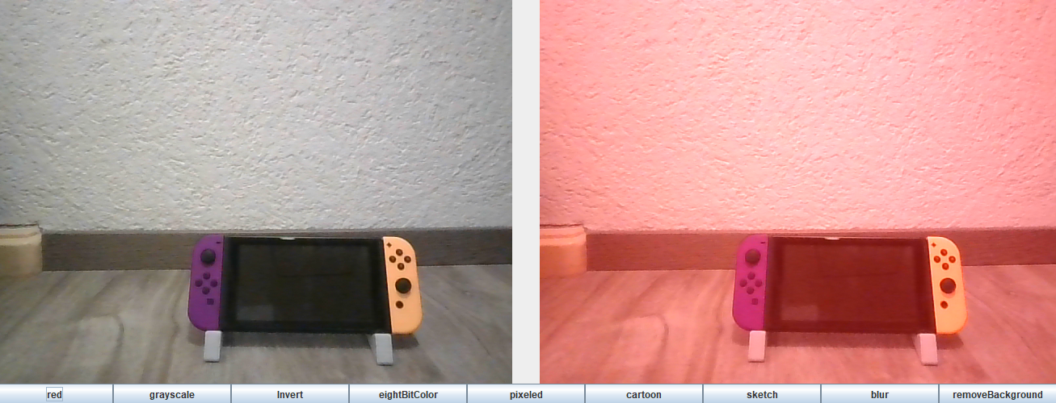
Red
Code
Beispiel
public static void redFilter(int[] pixels) {
for (int i = 0; i < pixels.length; i++) {
int pixel = pixels[i];
int red = (pixel >> 16) & 0xff;
int green = (pixel >> 8) & 0xff;
int blue = (pixel) & 0xff;
red += 100;
// Clamp the value of the red channel to range 0-255
red = Math.min(255, red);
// Combine modified values into a single pixel value
pixels[i] = (red << 16) | (green << 8) | blue;
}
}

Slide 4
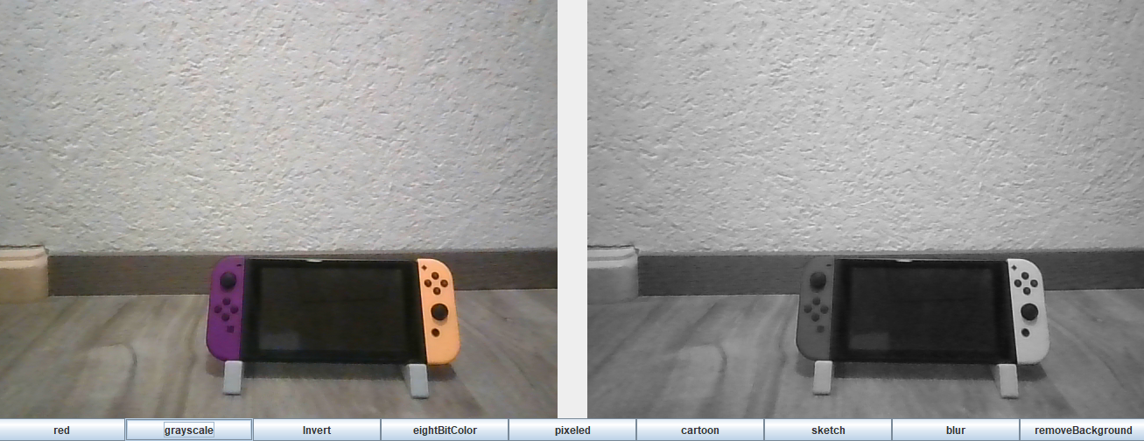
Grayscale
Code
Beispiel
public static void grayScale(int[] pixels) {
for (int i = 0; i < pixels.length; i++) {
int pixel = pixels[i];
int red = (pixel >> 16) & 0xff;
int green = (pixel >> 8) & 0xff;
int blue = (pixel) & 0xff;
int avg = (red + green + blue) / 3;
// Combined into a single pixel value
int grayscalePixel = (avg << 16)|(avg << 8) | avg;
pixels[i] = grayscalePixel;
}
}

Slide 5
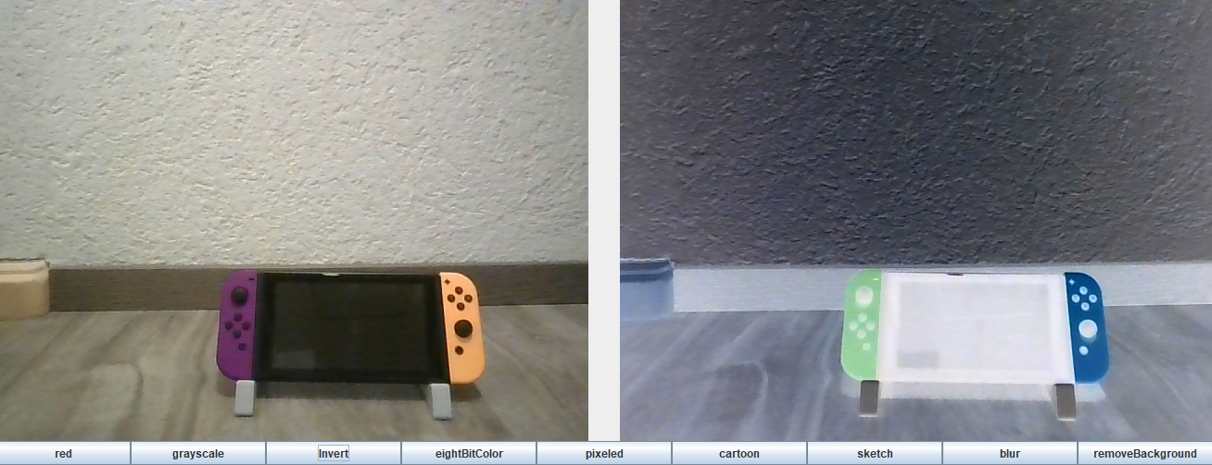
Invert
Code
Beispiel
public static void invertColors(int[] pixels) {
for (int i = 0; i < pixels.length; i++) {
int pixel = pixels[i];
int red = (pixel >> 16) & 0xff;
int green = (pixel >> 8) & 0xff;
int blue = (pixel) & 0xff;
// Invert the values of the r, g, b channels
red = 255 - red;
green = 255 - green;
blue = 255 - blue;
// Combined into a single pixel value
pixels[i] = (red << 16) | (green << 8) | blue;
}
}

Slide 6
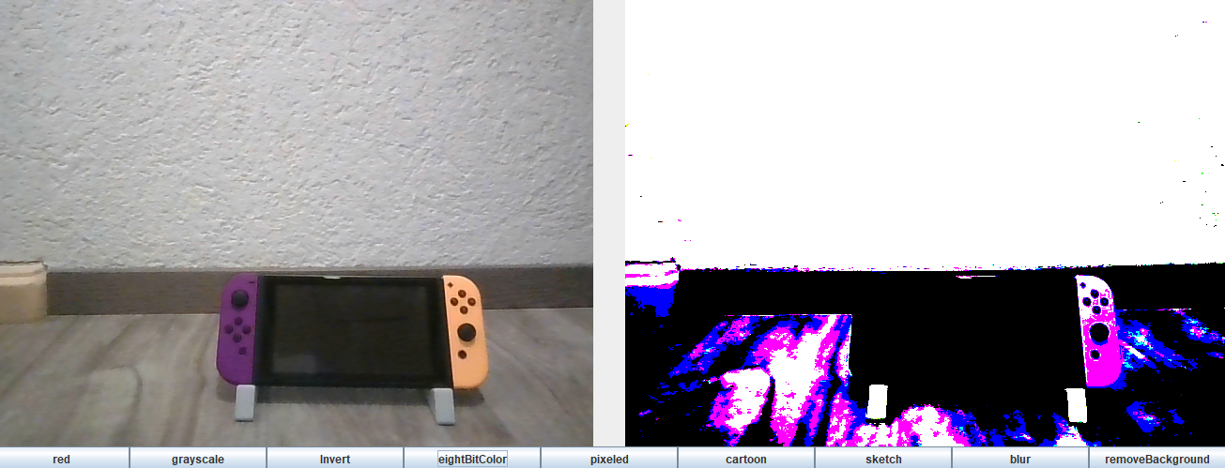
EightBit-Color
Code
Beispiel
public static void eightBitColor(int[] pixels) {
for (int i = 0; i < pixels.length; i++) {
int pixel = pixels[i];
int red = (pixel >> 16) & 0xff;
int green = (pixel >> 8) & 0xff;
int blue = (pixel) & 0xff;
red = red < 128 ? 0 : 255;
green = green < 128 ? 0 : 255;
blue = blue < 128 ? 0 : 255;
Color currentColor = new Color(green, blue, red);
int newIntColor =
(currentColor.getAlpha()<< 24) | (currentColor.getRed() <<16)| (currentColor.getGreen()<< 8) | currentColor.getBlue();
pixels[i] = newIntColor;
}}}

Slide 7
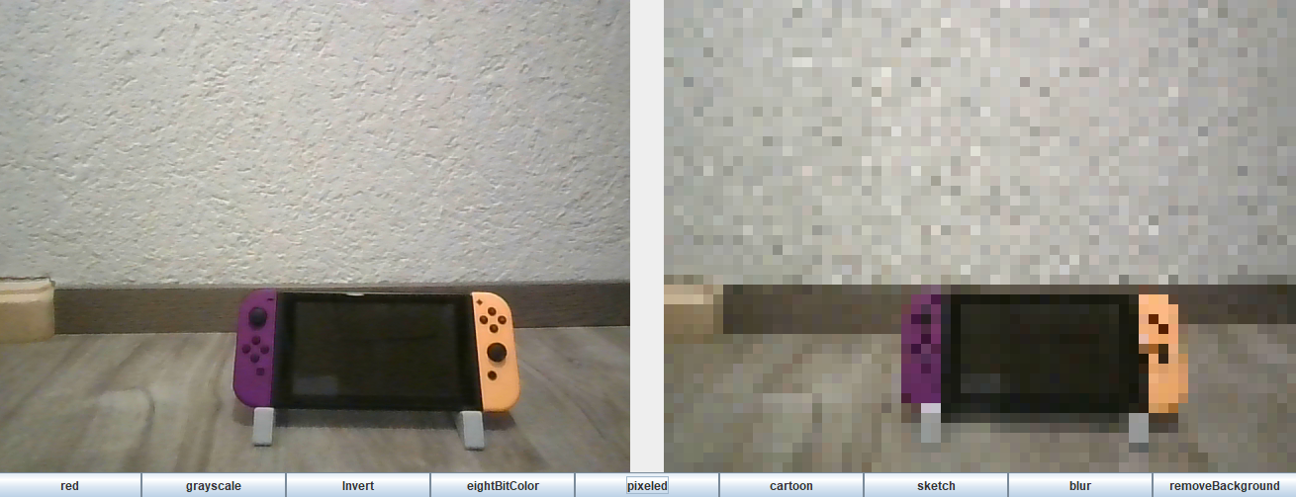
Pixeled
Code
Beispiel
public static void pixeled(int[] pixels, BufferedImage img, int width, int height) {
int pixelSize = 10; Color currentColor = new Color(0, 0, 0);
for (int y = 0; y < height; y++) {
if (y % pixelSize == 0) {
for (int x = 0; x < width; x++) {
if (x % pixelSize == 0) {
currentColor = Method.getPixelColor(img,
x + (pixelSize / 2) >= width ? width - 1 : x +(pixelSize / 2),
y + (pixelSize / 2) >= height ? height - 1 : y + (pixelSize / 2));}
int newIntColor =
(currentColor.getAlpha() << 24) |(currentColor.getRed()<< 16) | (currentColor.getGreen() << 8)| currentColor.getBlue();
pixels[x + (y * width)] = newIntColor;}
} else {
for (int x = 0; x < width; x++) {
pixels[x + (y * width)] = pixels[x + ((y - 1) * width)];}}}}

Slide 8
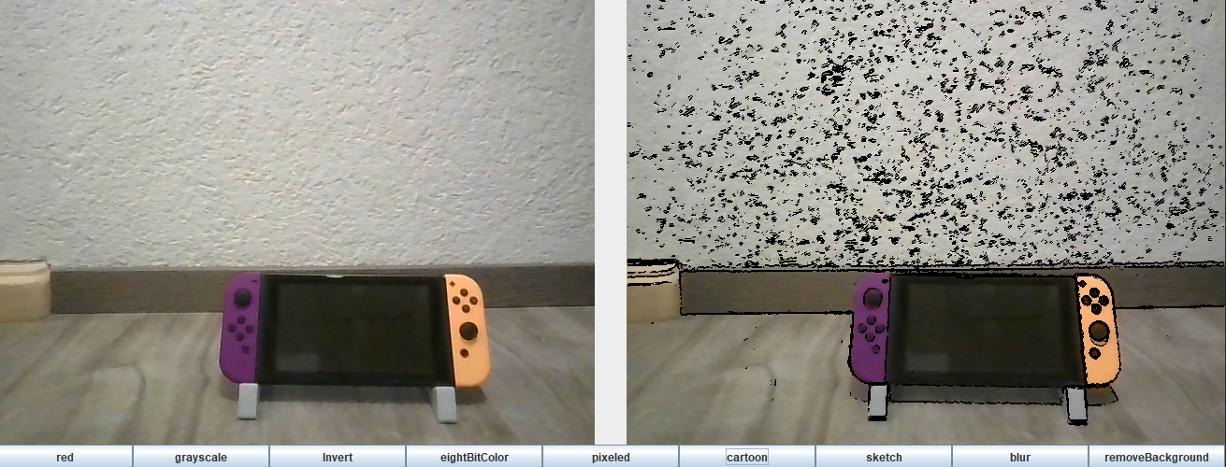
Cartoon
Code
Beispiel
public static void cartoon(int[]pixels, BufferedImage img, int width, int height){ int tolerance = 20;
for (int y = 1; y < height - 1; y++) {
for (int x = 1; x < width - 1; x++) {
Color currentColor = Method.getPixelColor(img, x, y);
Color lastColor = Method.getPixelColor(img, x - 1, y);
Color futureColor = Method.getPixelColor(img, x + 1, y);
Color lastColor2 = Method.getPixelColor(img, x, y - 1);
Color futureColor2 = Method.getPixelColor(img, x, y + 1);
if (Math.abs(Method.asGray(lastColor) - Method.asGray(futureColor)) > tolerance ||
Math.abs(Method.asGray(lastColor2) - Method.asGray(futureColor2)) > tolerance ||
Math.abs(Method.asGray(lastColor) - Method.asGray(futureColor2)) > tolerance ||
Math.abs(Method.asGray(lastColor2) - Method.asGray(futureColor)) > tolerance) {
currentColor = Color.black;}
int newIntColor = (currentColor.getAlpha() << 24) | (currentColor.getRed()<< 16)| (currentColor.getGreen() << 8) | currentColor.getBlue();
pixels[x + (y * width)] = newIntColor; }}}

Slide 9
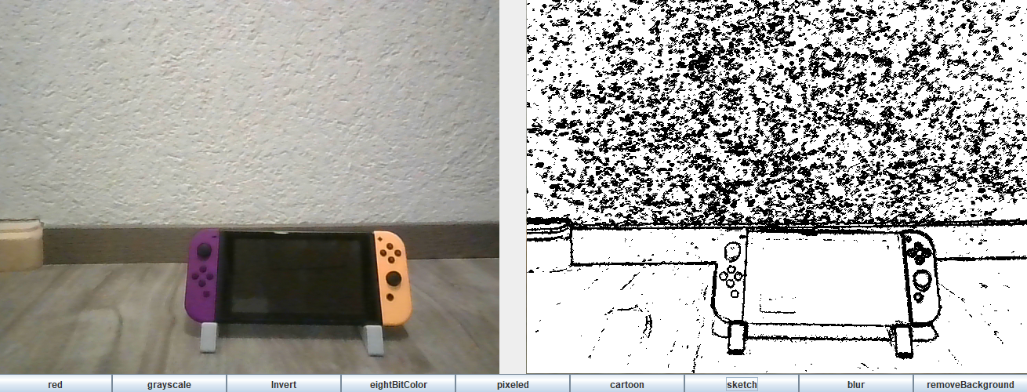
Sketch
Code
Beispiel
public static void sketch(int[] pixels, BufferedImage img, int width, int height) {
int tolerance = 10;
for (int y = 1; y < height - 1; y++) {
for (int x = 1; x < width - 1; x++) { …
… {
currentColor = Color.black;
} else {
currentColor = Color.white;
} int newIntColor =
(currentColor.getAlpha()<< 24) | (currentColor.getRed()<< 16)|
(currentColor.getGreen() << 8) | currentColor.getBlue();
pixels[x + (y * width)] = newIntColor;
}}}

Slide 10
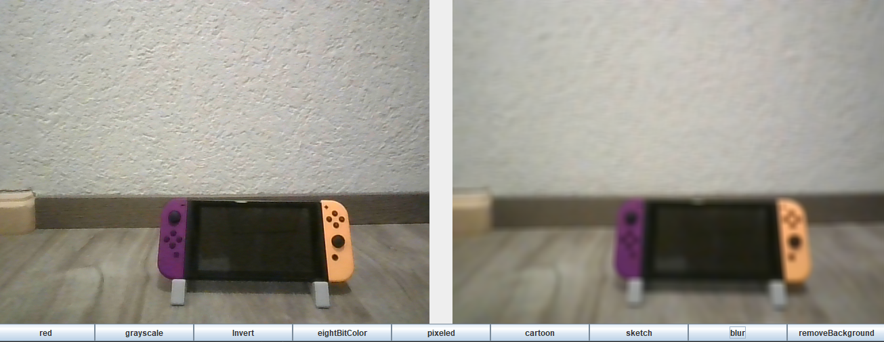
Blur
Code
Beispiel
public static void blur(int[] pixels, BufferedImage img, int width, int height) {
for (int x = 0; x < width; x++) {
for (int y = 0; y < height; y++) {
int radius = 5, left = x > radius ? x - radius : x, top = y>radius?y-radius : y ;
int right = x < width - radius - 1 ? x + radius : x;
int bottom = y < height - radius - 1 ? y + radius : y;
int SumR = 0, sumG = 0, sumB = 0, count = 0;
for (int i = left; i <= right; i++) {
for (int j = top; j <= bottom; j++) {
int pixel = img.getRGB(i, j);
int r = (pixel >> 16) & 0xff;
int g = (pixel >> 8) & 0xff;
int b = pixel & 0xff;
sumR += r; sumG += g; sumB += b;
count++; }}
int avgR = sumR / count; int avgG = sumG / count; int avgB = sumB / count;
int newPixel = (avgR << 16) | (avgG << 8) | avgB;
pixels[x + (y * width)] = newPixel; }}}
}
}
}

Slide 11
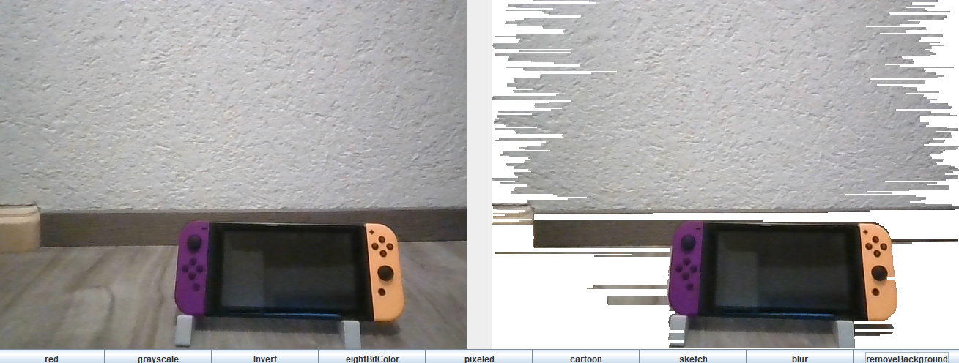
Remove background

Slide 12
Libraries und Quellen
java.awt (GUI)
javax.swing (GUI)
Github Sarxos (Webcam)
https://docs.oracle.com/javase/7/docs/api/java/awt/package-summary.html
https://docs.oracle.com/javase/7/docs/api/javax/swing/package-summary.html
https://github.com/sarxos/webcam-capture

